Slide 1
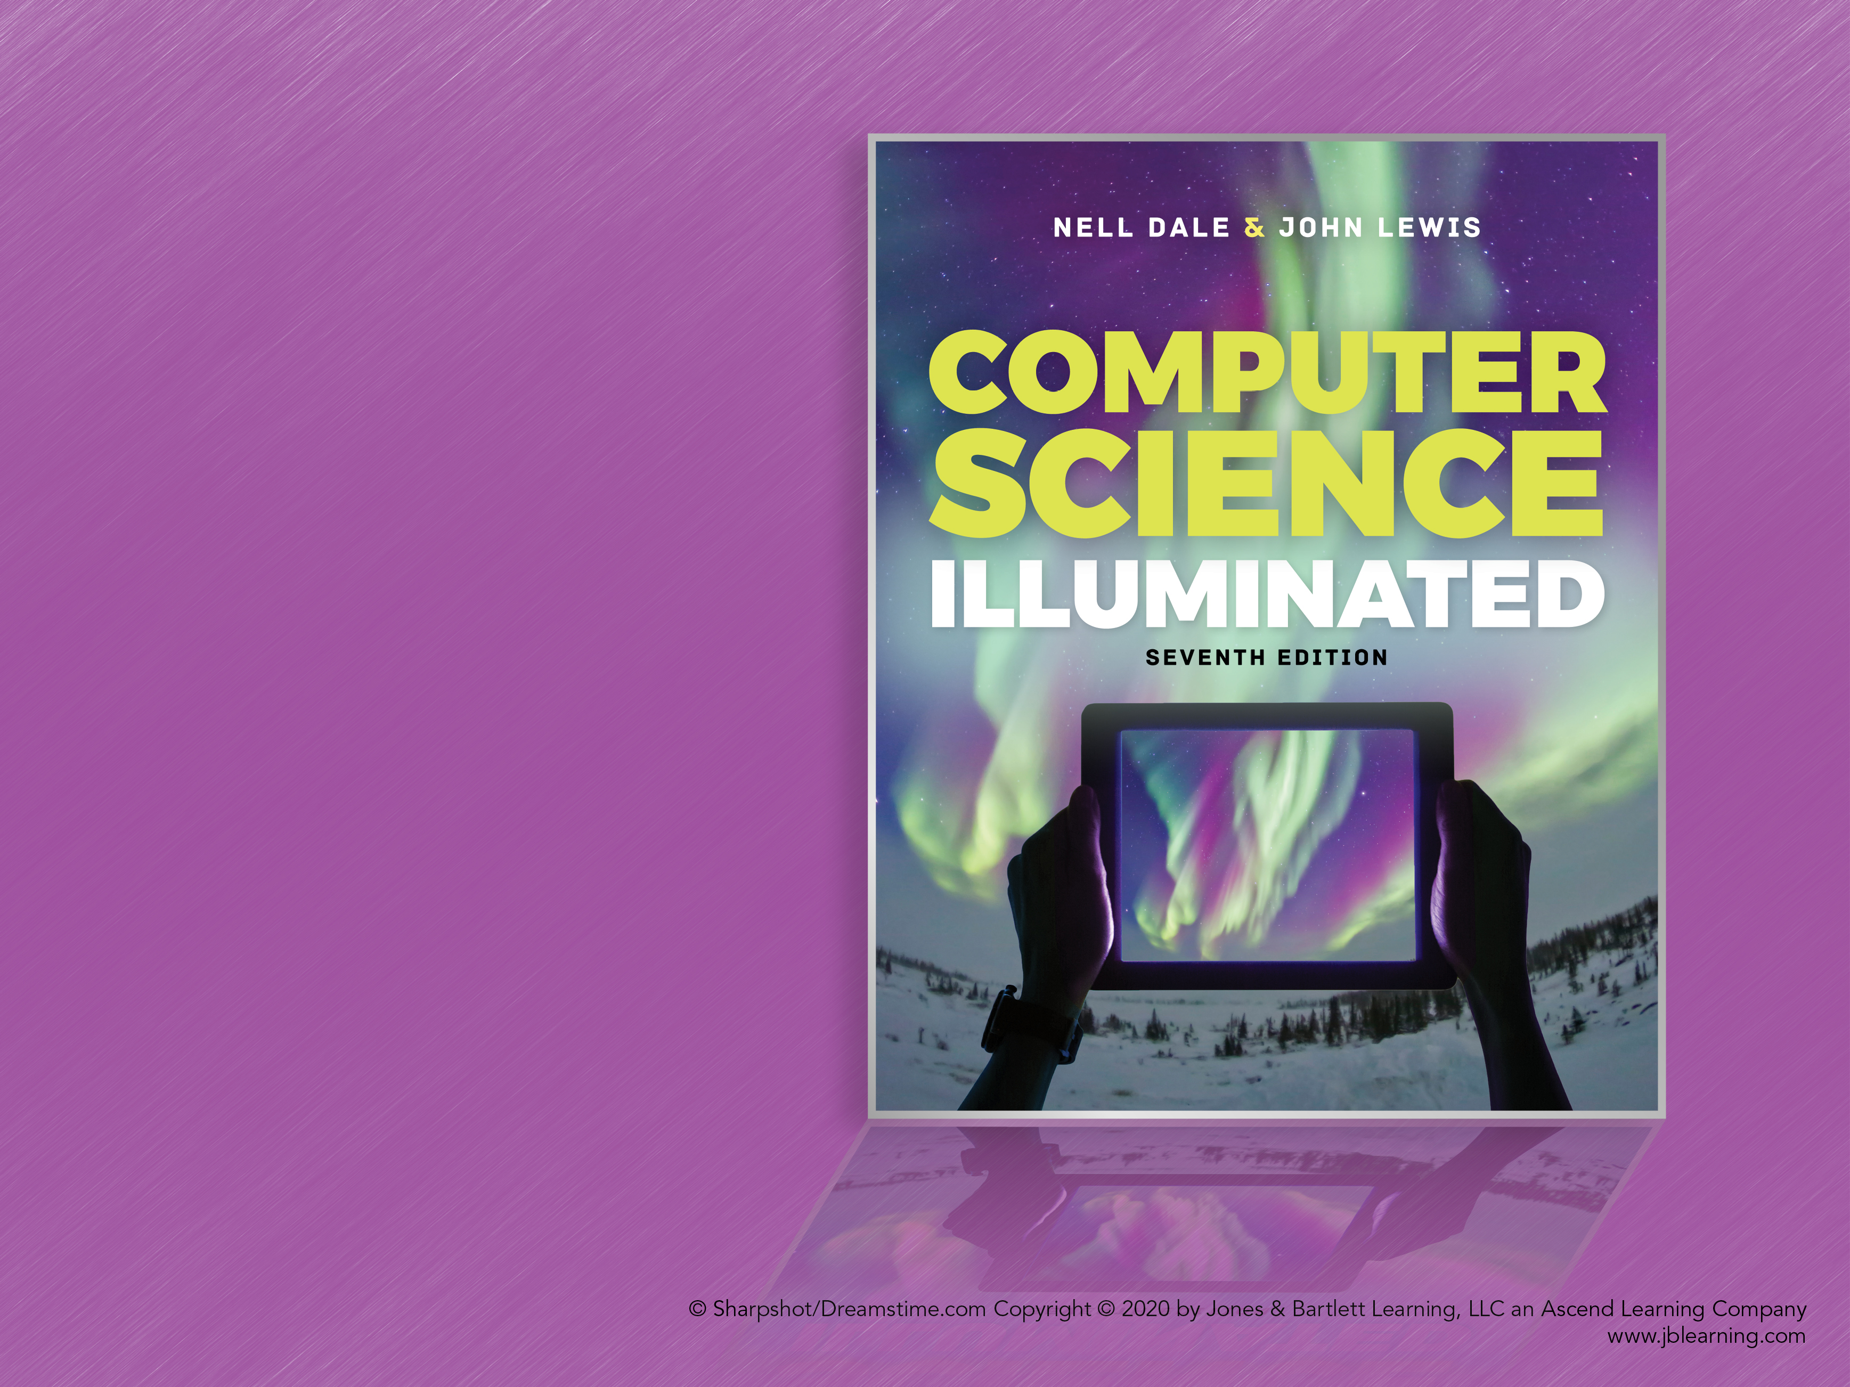
Chapter 1
The
Big
Picture

Slide 2
Chapter Goals
Describe the layers of a computer system
Describe the concept of abstraction and its relationship to computing
Describe the history of computer hardware and software
Describe the changing role of the computer user
Distinguish between systems programmers and applications programmers
Describe the big ideas underlying computing

Slide 3
Computing Systems (1 of 2)
Computing systems are dynamic!
What is the difference between hardware and software?

Slide 4
Computing Systems (2 of 2)
Hardware The physical elements of a computing system (printer, circuit boards, wires, keyboard, etc.)
Software The programs that provide the instructions for a computer to execute

Slide 5
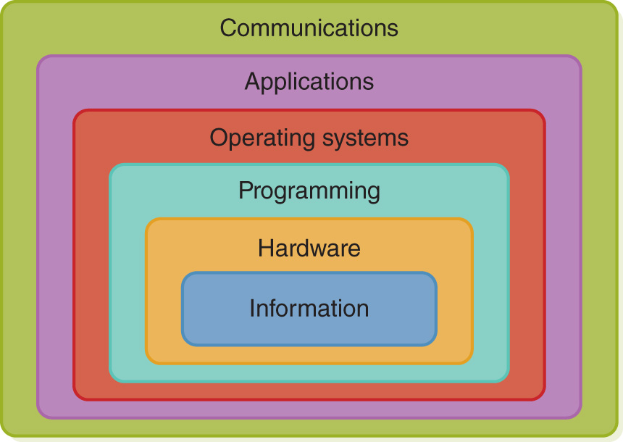
Layers of a Computing System

Slide 6
Abstraction
Abstraction A mental model that removes complex details
This is a key concept. Abstraction will reappear throughout the text—be sure you understand it!

Slide 7
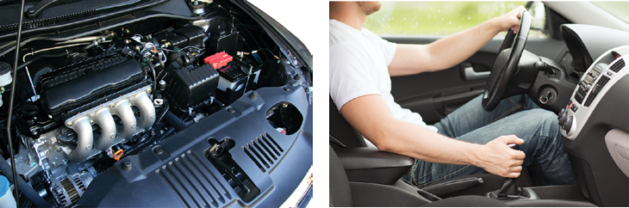
Internal and Abstract View
A car engine and the abstraction that allows us to use it
© aospan/Shutterstock.

Slide 8
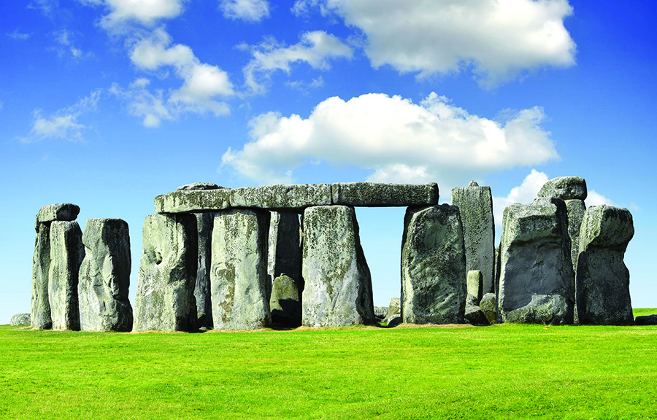
History
vencacolrab/iStock/Thinkstock

Slide 9
Early History of Computing (1 of 2)
Abacus
An early device to record numeric values
Blaise Pascal
Mechanical device to add, subtract, divide, and multiply
Joseph Jacquard
Jacquard’s Loom, the punched card
Charles Babbage
Analytical Engine

Slide 10
Early History of Computing (2 of 2)
Ada Lovelace
First programmer, the loop
Alan Turing
Turing machine, artificial intelligence testing
Harvard Mark I, ENIAC, UNIVAC I
Early computers launch new era in mathematics, physics, engineering, and economics

Slide 11
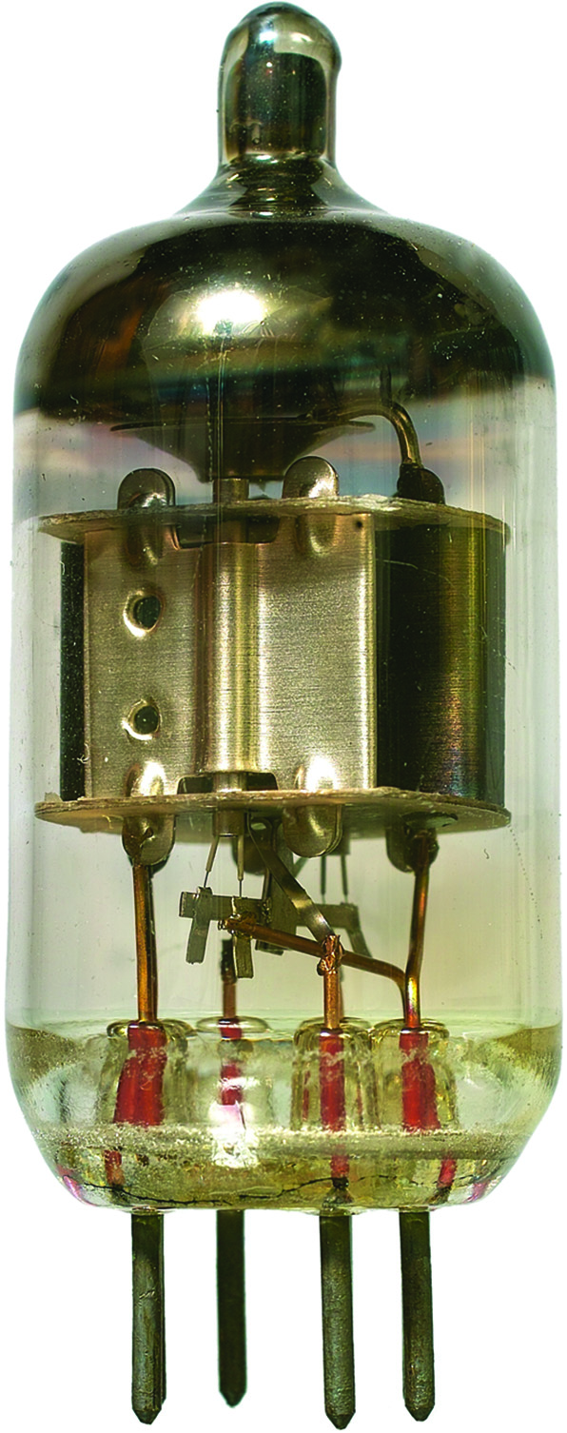
First-Generation Hardware (1951–1959)
Vacuum Tubes
Large, not very reliable, generated a lot of heat
Magnetic Drum
Memory device that rotated under a read/write head
Card Readers → Magnetic Tape Drives
Sequential auxiliary storage devices
© SPbPhoto/Shutterstock
A vacuum tube

Slide 12
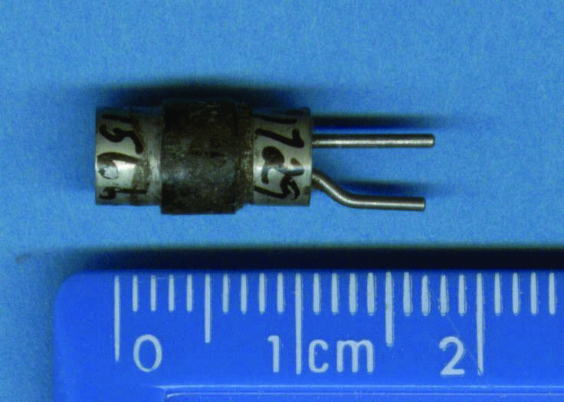
Second-Generation Hardware (1959–1965)
Transistor
Replaced vacuum tube; fast, small, durable, cheap
Magnetic Cores
Replaced magnetic drums, information available instantly
Magnetic Disks
Replaced magnetic tape, data can be accessed directly
Courtesy of Dr. Andrew Wyle
A transistor, which replaced the vacuum tube

Slide 13
Third-Generation Hardware (1965–1971)
Integrated Circuits
Replaced circuit boards; smaller, cheaper, faster, more reliable
Transistors
Now used for memory construction
Terminal
An input/output device with a keyboard and screen

Slide 14
Fourth-Generation Hardware (1971–?)
Large-scale Integration
Great advances in chip technology
PCs, the Commercial Market, Workstations
Personal computers and workstations emerge
New companies emerge: Apple, Sun, Dell, etc.
Laptops, Tablet Computers, and Smart Phones
Everyone has his/her own portable computer

Slide 15
Parallel Computing and Networking
Parallel Computing
Computers rely on interconnected central processing and/or memory units that increase processing speed
Networking
Ethernet connects small computers to share resources
File servers connect PCs in the late 1980s
ARPANET and LANs → Internet

Slide 16
First-Generation Software (1951–1959)
Machine Language
Computer programs written in binary (1s and 0s)
Assembly Languages and Translators
Programs written using mnemonics, which were translated into machine language
Programmer Changes
Programmers divide into two groups: application programmers and systems programmers

Slide 17
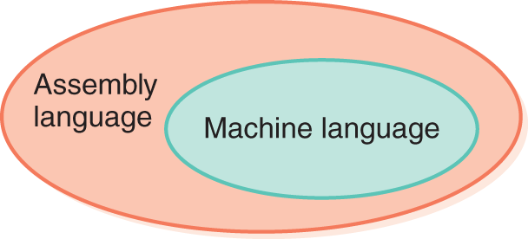
Assembly/Machine
Language layers in the first generation

Slide 18
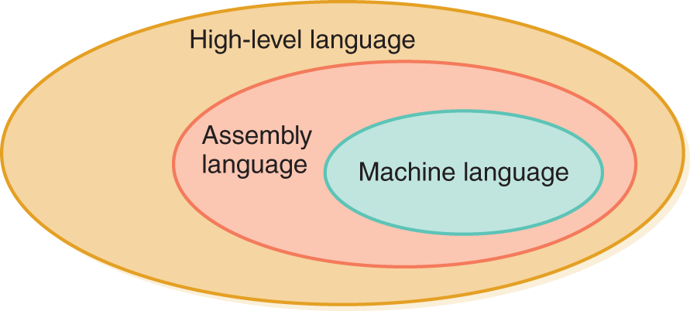
Second-Generation Software (1959–1965)
High-Level Languages
English-like statements made programming easier:
Fortran, COBOL, Lisp
Language layers in the second generation

Slide 19
Third-Generation Software (1965–1971) (1 of 2)
Systems Software
Utility programs
Language translators
Operating system, which decides which programs to run and when
Separation Between Users and Hardware
Computer programmers write programs to be used by general public (i.e., nonprogrammers)

Slide 20
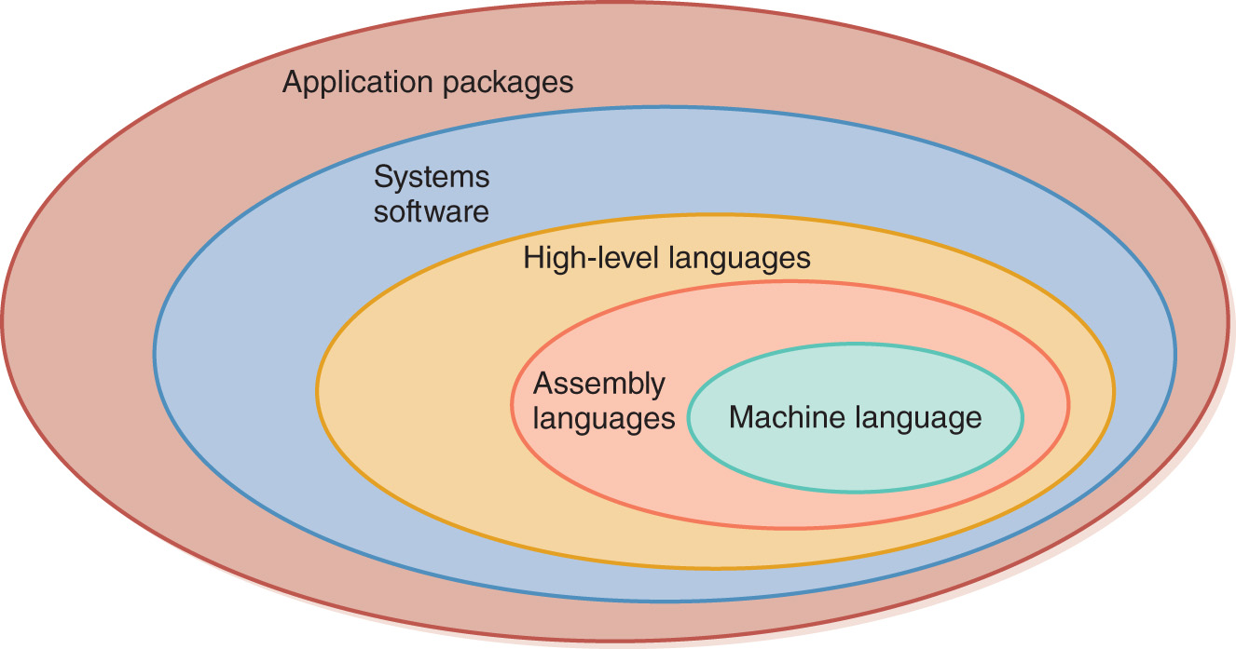
Third-Generation Software (1965–1971) (2 of 2)
The layers of software surrounding the hardware continue to grow

Slide 21
Fourth-Generation Software (1971–1989)
Structured Programming
Pascal
C++
New Application Software for Users
Spreadsheets
Word processors
Database management systems

Slide 22
Fifth-Generation Software (1990–present)
Microsoft
Windows operating system and other Microsoft application programs dominate the market
Object-Oriented Design
Based on a hierarchy of data objects (i.e., Java)
World Wide Web
Allows easy global communication through the Internet
New Users
Today’s user needs no computer knowledge

Slide 23
Computing as a Tool
Programmer/User
Systems Programmer
(builds tools)
Applications Programmer
(uses tools)
Domain-Specific Programs
User with No
Computer Background

Slide 24
Computing as a Discipline (1 of 2)
What can be (efficiently) automated?
Four Necessary Skills:
Algorithmic thinking
Representation
Programming
Design

Slide 25
Computing as a Discipline (2 of 2)
What do you think?
Is computer science a mathematical, scientific, or engineering discipline?
22

Slide 26
Examples of Systems Areas
Algorithms and data structures
Programming languages
Architecture
Operating systems
Software engineering
Human–computer communication
23

Slide 27
Examples of Application Areas
Numerical and symbolic computation
Databases and information retrieval
Intelligent systems
Graphics and visual computing
Net-centric computing
Computational science

Slide 28
Big Ideas of Computing
Creativity
Abstraction
Data and information
Algorithms
Programming
The Internet
Global impact

Slide 29
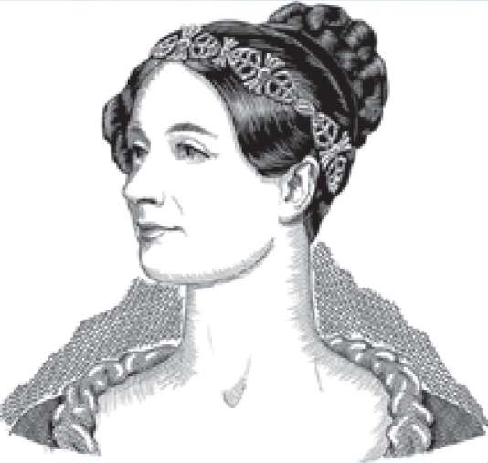
Who Am I?
Ada Lovelace, the First Programmer
Can you list three items on my resume?

Slide 30
Ethical Issues
Digital Divide
What disparity does the term “digital divide” describe? What is the E-Rate program? What is the One-Laptop-Per-Child program? What additional challenge must developing nations face?

Slide 31
Do You Know?
Who said the Analytical Engine “weaves algebraic patterns”?
Where did scientists build the first nanotube computer?
What computer company was launched in a garage?
What companies turned Jobs and Wozniak away?
Where is the Computer History Museum?
What is Room to Read?
When and where were the first CS Departments formed?

